Slide 1
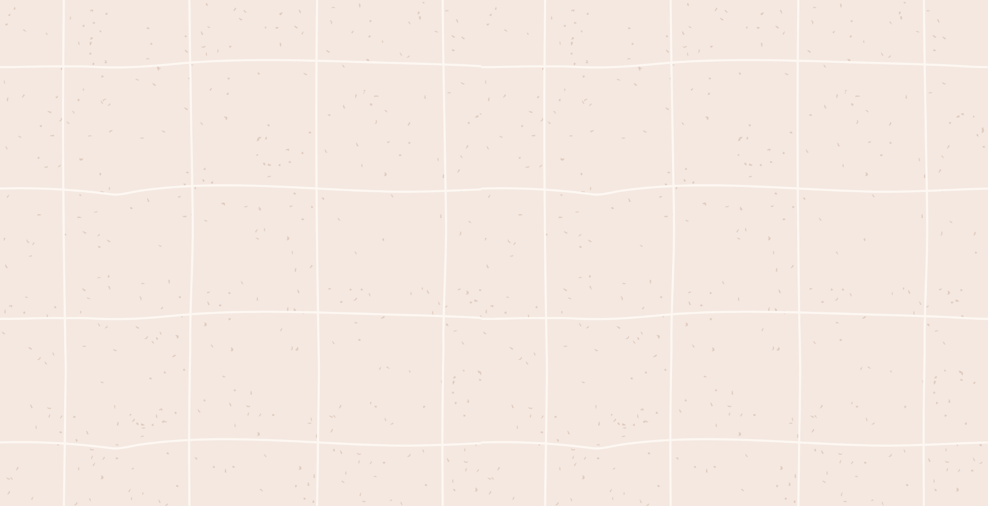
DATA ANALYST INTERNSHIP ON KULTUREHIRE
Project Title: Understanding Career Aspirations of Gen Z
KEDARI SRI VENKATESH

Slide 2
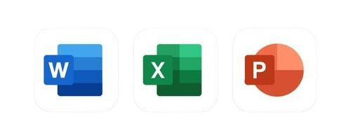




Understanding Career Aspirations of Gen Z
KEDARI SRI VENKATESH

Slide 3
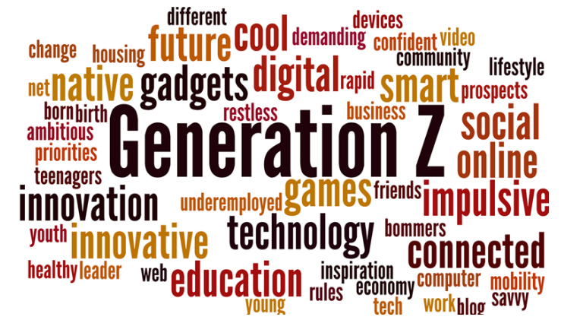
Introduction
The project titled "Understanding Career Aspirations of Gen Z" aims to explore the evolving career goals, values, and expectations of the Gen Z demographic — individuals born between the mid-1990s and early 2010s. As this generation begins to enter the workforce in significant numbers, it becomes crucial for organizations, recruiters, and educators to understand their unique aspirations, motivations, and decision-making factors. This study leverages data analytics to identify trends in industry preferences, desired work environments, skill development priorities, and salary expectations among Gen Z individuals. By analyzing survey responses and digital engagement patterns, the project provides actionable insights that can help shape more effective talent acquisition strategies, workplace policies, and career guidance initiatives tailored to this dynamic and tech-savvy generation.

Slide 4
My Progress
01
Problem statement
02
Data Collection
Gen Z offers digital skills and diversity but faces mental health challenges.
Created a Google Form with tailored questions to collect data on Gen-Z's career aspirations.
Data Cleaning and
standardisation
03
04
Exploratory Data analysis
Raw dataset given by the mentor to me. In this process I used Excel to covert the raw to useful dataset.
In this step, Mainly I focuses on creating the pivot tables.
Note: I Uploaded my work on my GitHub and I mentioned the each and every task at picture link format and please check on my profile also……..

Slide 5
My Progress
05
Analysing in SQL
06
Dashboarding in Excel
In this step, I used the some major queries to analyze the dataset for most asked questions.
Creating an Dashboarding using Excel for analyses the data with KPI cards and slicers
Dashboarding
In Power BI
07
08
Presentation
Developed three focused dashboards for each area, incorporating KPIs, Power Query Editor, measures, and groups in Power BI.
Worked on an GenZ-focused project, creating recommendations and emphasizing the importance of storytelling in data.
Note: I Uploaded my work on my GitHub and I mentioned the each and every task at picture link format and please check on my profile also……..

Slide 6
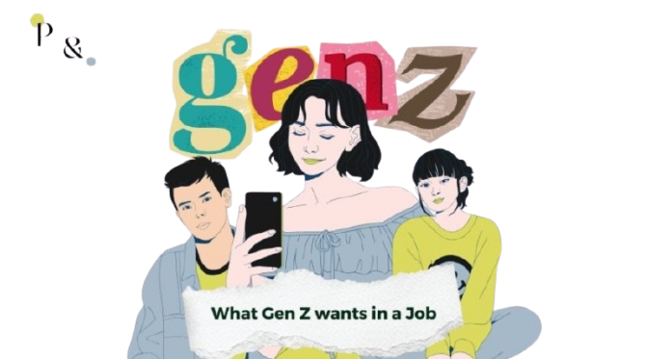
Welcome To Presentation
Analyzing Trends, Motivations, and Workforce Expectations of the Next Generation Let me know if you want variations (e.g., more formal, creative, or technical)

Slide 7



01
Problem Statement
My view
Understanding and Addressing the Workplace Challenges and Career Aspirations of Generation Z
Generation Z is entering the workforce with strong digital skills but faces challenges related to mental health, communication, and workplace adaptability. This study explores their aspirations, identifies key barriers to productivity, and proposes strategies for better engagement and support.
Tools Used: Microsoft Word

Slide 8
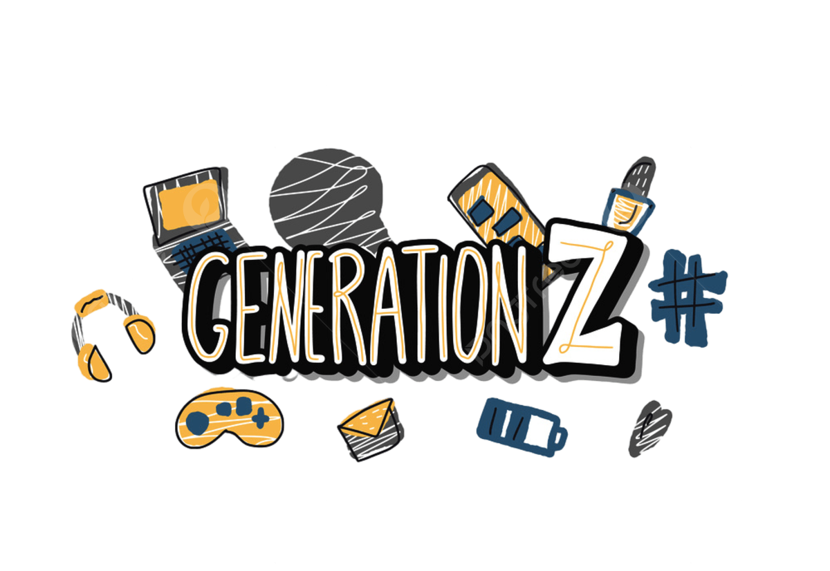

My Work
🔧 Main Tasks Performed:
Problem Identification using 5W1H Framework
Broke down the issue into Who, What, When, Where, Why, How
to understand Gen Z’s workforce behavior.
Data Analysis and Insight Extraction
Interpreted survey data and employment trends from the UK and US regarding Gen Z productivity and mental health.
Contextual Analysis
Linked the impact of global events like the COVID-19 pandemic to Gen Z’s workforce behavior.
Comparative Research
Compared generational behavior, workplace expectations, and mental health trends across regions and time.
Solution Recommendation
Suggested practical interventions like flexible work arrangements and inclusive cultures to support Gen Z.
Report Writing & Summarization
Compiled findings into a structured, cohesive narrative including a detailed conclusion.

Slide 9
02
Data Collection
My view
The data collection for the project “Generation Performance Between Age Groups” was carried out using a structured Google Form. The primary goal was to analyze how different generations perform in their careers after graduation, focusing on factors like job acquisition, workplace experiences, and career development.
🧠 In Simple Terms:
The form helped to compare career journeys across age groups, understand how they learn, grow, and adapt in the workplace, and figure out what motivates them or holds them back. This information can be used to guide better education systems, training programs, and career support for different generations.
Tools Used: Google Forms

Slide 10
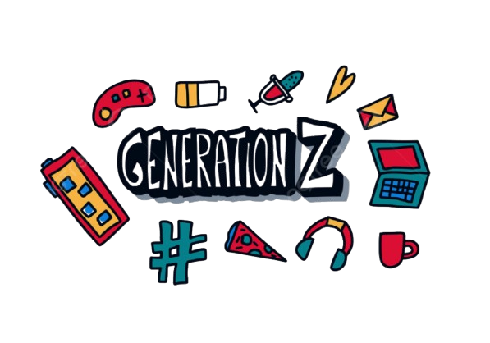
My Work
Through this process, valuable information was gathered on:
Demographics such as age, education level, and graduation year,
to categorize respondents into generations (Gen Z, Millennials, etc.).
Employment status and job acquisition timelines, which helped understand
how quickly different generations find jobs after finishing their education.
Work environment preferences (remote, hybrid, office-based), and current job roles, to study generational choices and career positions.
Job switching habits and expected duration in roles, revealing how stable or flexible younger and older generations are in their careers.
Career motivations (like salary, learning, job stability), and future goals (like starting a business or switching careers), to uncover what drives people at different life stages.
Skill development patterns, including how individuals learn new skills (college, online, mentorship, etc.) and whether their education prepared them well for their jobs.
The importance of continuous learning and whether people pursue extra certifications or training to stay updated in their fields.
Personal insights, via open-ended responses, on current job roles or reasons for unemployment, offering deeper understanding beyond multiple-choice data.

Slide 11

03
Data Cleaning and standardisation
My view
This dataset focuses on the career aspirations of students and early professionals using data collected from a Google Form survey. The dataset, with over 3,900 responses, includes details about career preferences, work environments, salary expectations, and future goals.
Before analysis, the raw data was cleaned to remove unnecessary columns, fix missing values, and standardize formats—making it ready for meaningful insights and visualizations.
Tools Used: Microsoft Excel

Slide 12

My Work
🧼 Raw to Cleaned Data Conversion – Process Overview
🔹 1. Remove Empty or Irrelevant Columns
Issue: Columns .1, .2, etc., were completely empty.
Fix: Removed all columns with no data using .dropna(axis=1, how='all').
🔹 2. Remove Personal Identifiable Information (Optional)
Issue: Fields like "Email address" and "Zip Code" aren't needed for analysis.
Fix: Dropped these columns to ensure privacy and avoid redundancy.
🔹 3. Rename Long Column Headers
Issue: Many columns had very long and unclear labels, making them hard to read.
Fix: Renamed columns to shorter, meaningful names (e.g., Expected_Salary_3Yrs, Gender, Preferred_Employer).
🔹 4. Handle Missing Values
Issue: Some rows had missing values in key columns.
Fixes:
Dropped rows with missing critical information like Gender or Career_Influence.
For non-critical fields, filled missing values with "Not specified".

Slide 13

My Work
🔹 5. Standardize Data Formats
Issue: Salary fields were stored as text with symbols (₹, commas).
Fix: Cleaned the text using regex and converted them to integers for analysis.
🔹 6. Split Consistent vs. Incomplete Responses
Issue: First 20+ columns were answered by all, but the rest (from column 21 onward) were only partially filled (~490 rows).
Fix: Treated the dataset as two parts:
Core Dataset (3,931 full responses)
Extended Dataset (490 detailed responses)
🔹 7. Save as Cleaned Dataset
Saved the cleaned data to a new Excel file, ready for further analysis or visualization.

Slide 14
04
Exploratory Data analysis
My view
Exploratory Data Analysis (EDA) is a critical step in data analysis that helps to understand the dataset, uncover patterns, and detect anomalies before applying advanced modeling techniques. It involves summarizing the dataset, identifying relationships between variables, and checking assumptions.
Key Questions in EDA:
What are the distributions of key numeric variables (e.g., salary, experience)?
How do categorical variables (e.g., gender, employer preference) vary?
Are there correlations between key variables (e.g., career influence vs. salary)?
Are there any outliers or missing values that need addressing?
Pivot Tables in EDA:
Pivot tables allow you to summarize and analyze data by:
Aggregating data (e.g., summing salaries by gender).
Exploring relationships between variables
(e.g., salary by employer preference).
Tools Used: Microsoft Excel

Slide 15

My Work
Procedure:
Steps to Create Pivot Tables:
Select Data: Highlight the dataset (ensure no blank rows/columns).
Insert Pivot Table: Go to Insert > PivotTable.
Choose Fields: Drag fields into Rows, Columns, Values, and Filters.
Summarize: Adjust value settings (e.g., Sum, Average).
Format & Organize: Customize table appearance and sort data.
Analyze: Look for patterns, trends, and relationships.
Apply Filters: Refine the data using filters for more focused analysis.
This provides a quick guide to creating and using pivot tables in Excel.

Slide 16
My Work
Some Examples are:
1. Career Aspirations by Gender
Question: What influences career aspirations the most based on gender?
Pivot Table:
Rows: Gender
Columns: Career_Influence
Values: Count of responses
Insight: Helps identify whether men and women are more influenced by social media, role models, or family.
3. Salary Expectations by Learning Style
Question: How do expected salaries relate to preferred learning styles?
Pivot Table:
Rows: Learning_Style
Columns: Expected_Salary_3Yrs (bucketed, if needed)
Values: Count or average salary
Insight: Reveals how hands-on learners vs. classroom learners differ in salary expectations.
2. Work Environment Preference by Country
Question: Which work environment (Remote, Hybrid, Office) is most preferred in different countries?
Pivot Table:
Rows: Country
Columns: Work_Environment
Values: Count of responses
Insight: Shows geographical trends in work flexibility preferences.
4. Higher Education Interest Based on Salary Expectation
Question: Do people aiming for higher salaries also plan to study abroad?
Pivot Table:
Rows: Higher_Ed_Abroad
Columns: Salary Ranges (Expected_Salary_5Yrs)
Values: Count of responses
Insight: Links long-term salary goals with education choices.

Slide 17

My Work
Overall Summary:
Exploratory Data Analysis (EDA) was performed to discover key trends and patterns in the cleaned dataset. Pivot tables were used to explore relationships between career preferences, demographics, and expectations.
🔍 Key Findings:
Career influences vary by gender, with differences in motivation from social media, role models, and peers.
Work environment preferences (remote, hybrid, office) differ across countries.
Salary expectations are linked to learning styles—self-learners tend to expect more.
Willingness to stay long-term with an employer varies by gender.
Higher education goals often align with higher salary expectations.
This analysis provides valuable insight into the mindset of today’s youth regarding careers.

Slide 18
05
Data Analysing using SQL
My view
This focuses on understanding the career preferences, motivations, and expectations of Gen-Z individuals through structured data analysis using SQL queries. The dataset includes responses from both males and females, providing insights into their desired work environments, key career influences, salary expectations, and personal values.
SQL was used to query and analyze the data across multiple dimensions, allowing us to:
Identify preferred work environments by gender.
Understand top influences on career choices and their average impact scores.
Compare salary expectations over 3 and 5 years.
Evaluate how social impact and personal values influence career decisions.
Discover the most popular industries Gen-Z aspires to work in.
This analysis offers valuable insights into how the next generation of professionals is shaping their career paths and what factors drive their decisions.
Tools Used: MySQL

Slide 19

My Work
Overview of SQL Queries:
✅ 1. Desired Work Environment for Gen-Z (Males vs. Females)
Example Insight:
The analysis shows that both males and females prefer hybrid work models, with "Hybrid-Frequent" and "Hybrid-Moderate" being among the top choices. However, females show a slightly higher preference for remote-flexible environments, indicating a stronger inclination toward flexibility and work-life balance.
✅ 2. Top Factors Influencing Career Choices
Example Insight:
Among the influencing factors, entrepreneurs and mentors had higher average impact ratings from both genders, suggesting that Gen-Z looks up to self-made individuals and real-world guidance more than traditional influences like movies or social media. Parents and friends had moderate influence, especially among females.

Slide 20

My Work
Overview of SQL Queries:
✅ 3. Financial Goals and Career Aspirations
Example Insight:
A large portion of male respondents expect a monthly salary of ₹50,000–₹70,000 after 5 years, while female respondents most frequently expected around ₹40,000–₹60,000. This indicates ambitious financial goals among Gen-Z, with slightly different expectations between genders.
✅ 4. Role of Personal Values and Social Impact
Example Insight:
Respondents who rated mission integrity and clarity highly also reported a stronger inclination toward jobs that provide social impact. Females, in particular, showed a higher average social impact score when evaluating company values, suggesting that Gen-Z females prioritize ethical and meaningful work.
✅ 5. Most Preferred Industries
Example Insight:
The top industries among males included Technology, Entrepreneurship, and Finance, while females showed higher interest in Healthcare, Education, and Creative fields like Media & Design. This reflects a diverse range of aspirations shaped by gender and personal passion.

Slide 21
06
Dashboarding Using Excel
My view
This Dashboard focuses on analyzing survey data collected from individuals across India to understand their career preferences, educational goals, work environments, and salary expectations. Using Microsoft Excel, the raw data was cleaned and summarized through pivot tables to uncover key patterns.
The analysis covers various aspects such as gender distribution, preferred modes of work, and future salary expectations. Pivot tables were used to organize the data, while the dashboard (in Excel) was designed to visually present these insights in an interactive way.
A total of 171 responses were collected, with participants sharing details about their goals, motivations, and job expectations. Using pivot tables and charts, the data was cleaned, organized, and visualized in an easy-to-understand format.
Tools Used: Microsoft Excel

Slide 22

My Work
Dashboarding Process:
The dashboard was created by following a step-by-step approach to turn raw
survey data into meaningful insights. Here’s how the process was carried out:
1. Data Collection Collected responses from 171 participants through a survey. Data included gender, career goals, education plans, salary expectations, and work preferences.
2. Data Cleaning Removed any duplicates and checked for missing or incomplete entries. Reformatted some columns for better readability (e.g., salary ranges, work modes).
3. Planning Key Questions Identified important questions to answer through the dashboard such as:
What influences career choices the most?
What are the preferred working conditions?
How do salary expectations vary over time?
Who plans to pursue higher education?

Slide 23

My Work
Dashboarding Process:
4. Creating Pivot Tables Built pivot tables to summarize:
Gender distribution
Work mode preferences by gender
Salary expectations over 3 and 5 years
Career influencers and education plans
5. Designing the Dashboard
Created charts and visuals (bar charts, pie charts, etc.)
using the pivot data.
Used Excel’s formatting tools and slicers for interactivity
and better user experience.
6. Final Touches
Organized visuals for clear storytelling.
Highlighted key stats and trends in a visually appealing layout.

Slide 24
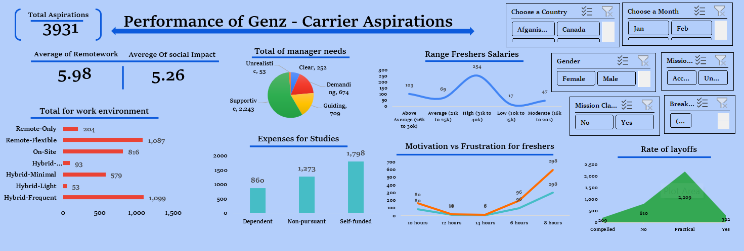
My Dashboarding Work

Slide 25
07
Dashboarding Using Power-BI
My view
This Power BI dashboard explores the thoughts and preferences of Gen Z when it comes to careers, managers, learning, and work life. It uses survey data to understand what Gen Z expects from their jobs and workplaces.
The dashboard shows:
What motivates Gen Z in their careers
What kind of managers and teams they prefer
Their learning styles and work setup choices
Salary expectations over 3 and 5 years
Who and what influences their decisions This analysis helps us understand how Gen Z wants to grow, work, and succeed in today’s world.
Tools Used: Microsoft Power-BI

Slide 26

My Work
Dashboarding Process:
The Gen Z Dashboard was built using Power BI to analyze the responses of over 2,800+ individuals from Gen Z. The process involved several key steps to convert raw data into meaningful insights.
1. Data Collection
Gathered responses from 2,800+ Gen Z participants.
Survey included questions on career clarity, manager preferences, learning modes, salary expectations, and personal influences.
2. Data Cleaning & Structuring Removed duplicates and handled missing values. Standardized categories like:
1.Work Modes (Hybrid, Remote, On-Site)
2.Salary Ranges (e.g., ₹30k–50k, ₹71k–90k, >₹151k)
3.Time Frames (3 years, 5+ years)
3. Defining Focus Areas The dashboard was divided into 3 main sections: 1. Mission Aspirations – e.g., 72% of Gen Z have clarity in their career goals.
2. Manager Expectations – e.g., 2,268 prefer supportive managers.
3. Learning Preferences – e.g., 46% prefer hybrid work setups.

Slide 27

My Work
Dashboarding Process:
4. Visual Creation in Power BI Used over 20+ visualizations including 1. Bar Charts (e.g., salary expectations by year)
2. Pie Charts (e.g., education funding types)
3. Stacked Columns (e.g., work mode preferences by gender)
Sample Data:
1,416 want to work under supportive managers.
1,099 prefer Hybrid-Frequent work setup.
1,400+ are influenced by parents in career choices.
5. Dashboard Layout & Design - Organized visuals into thematic sections for clarity. - Used slicers and filters for interactivity.
-Applied clean design with readable fonts, color consistency, and tooltips for better storytelling.
6. Review & Insights
Final dashboard was reviewed for clarity, accuracy, and usability. Designed to help employers understand how to attract, support, and retain Gen Z talent.

Slide 28
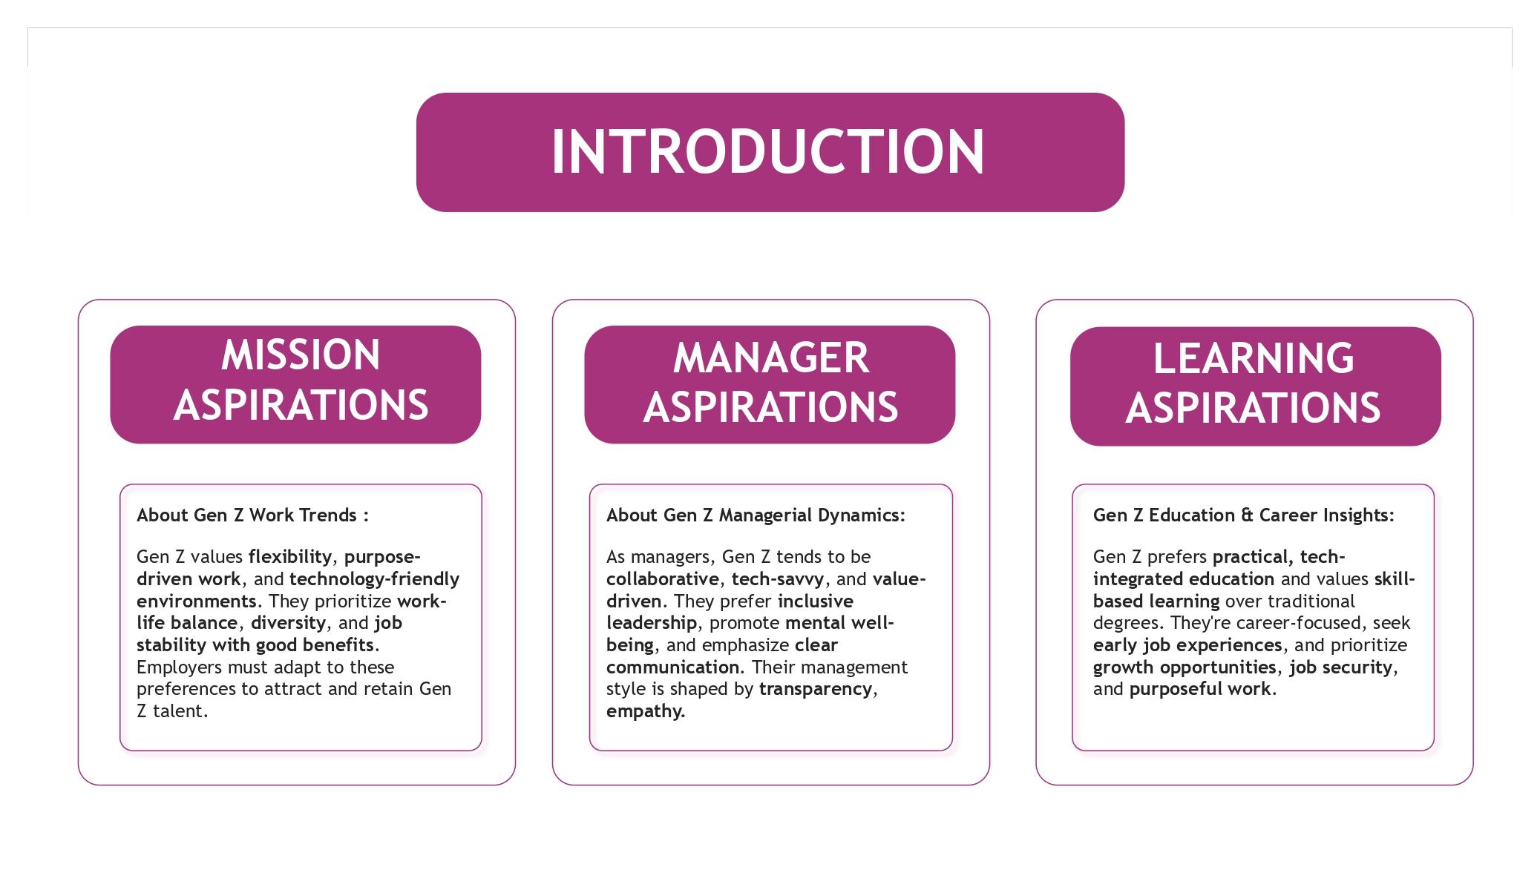
My Dashboarding Work

Slide 29
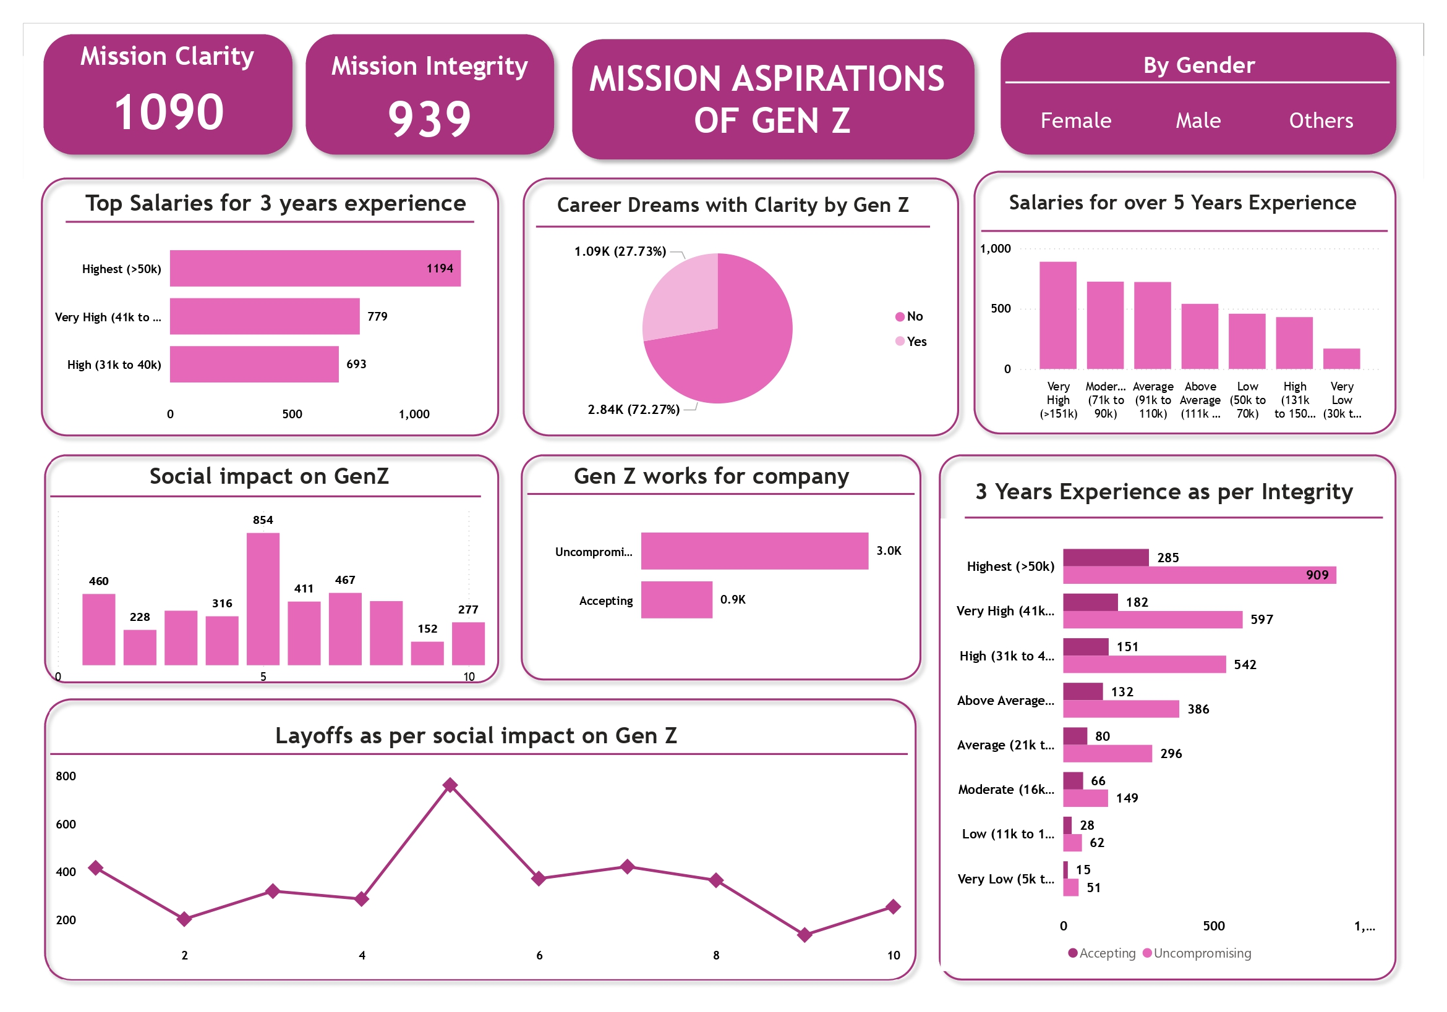
My Dashboarding Work

Slide 30
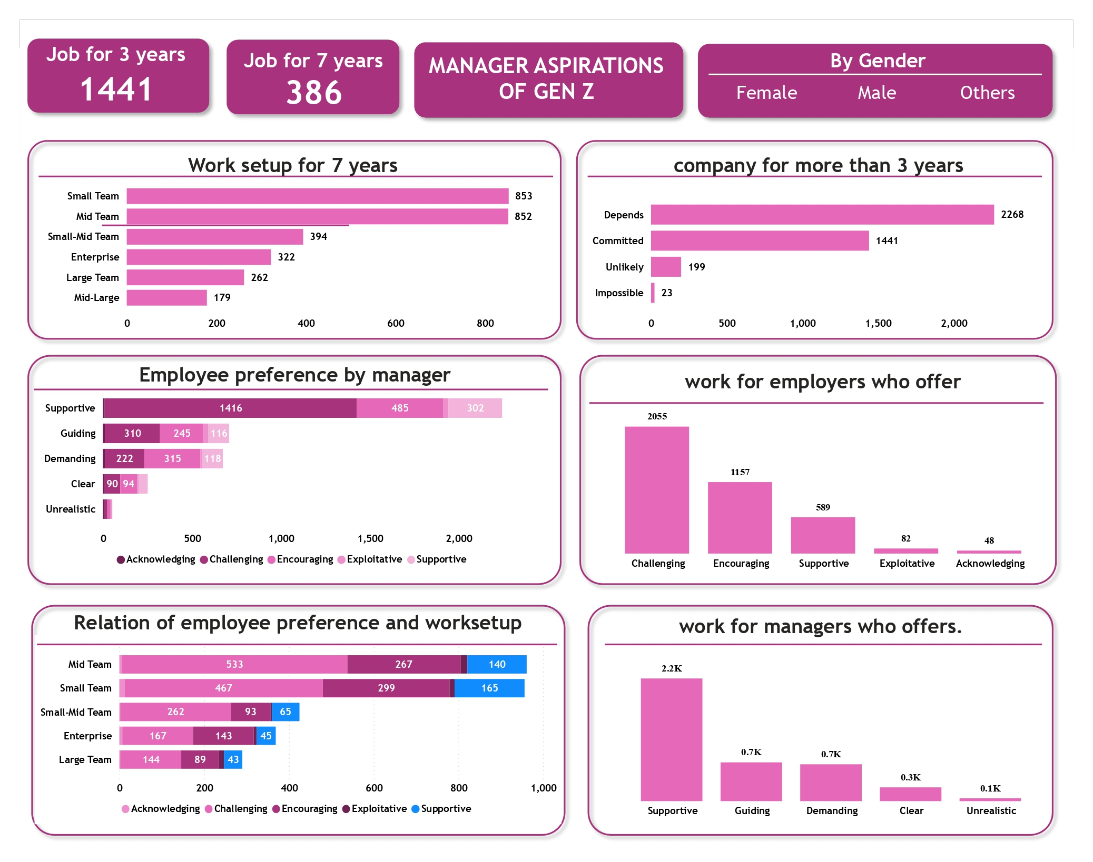
My Dashboarding Work

Slide 31
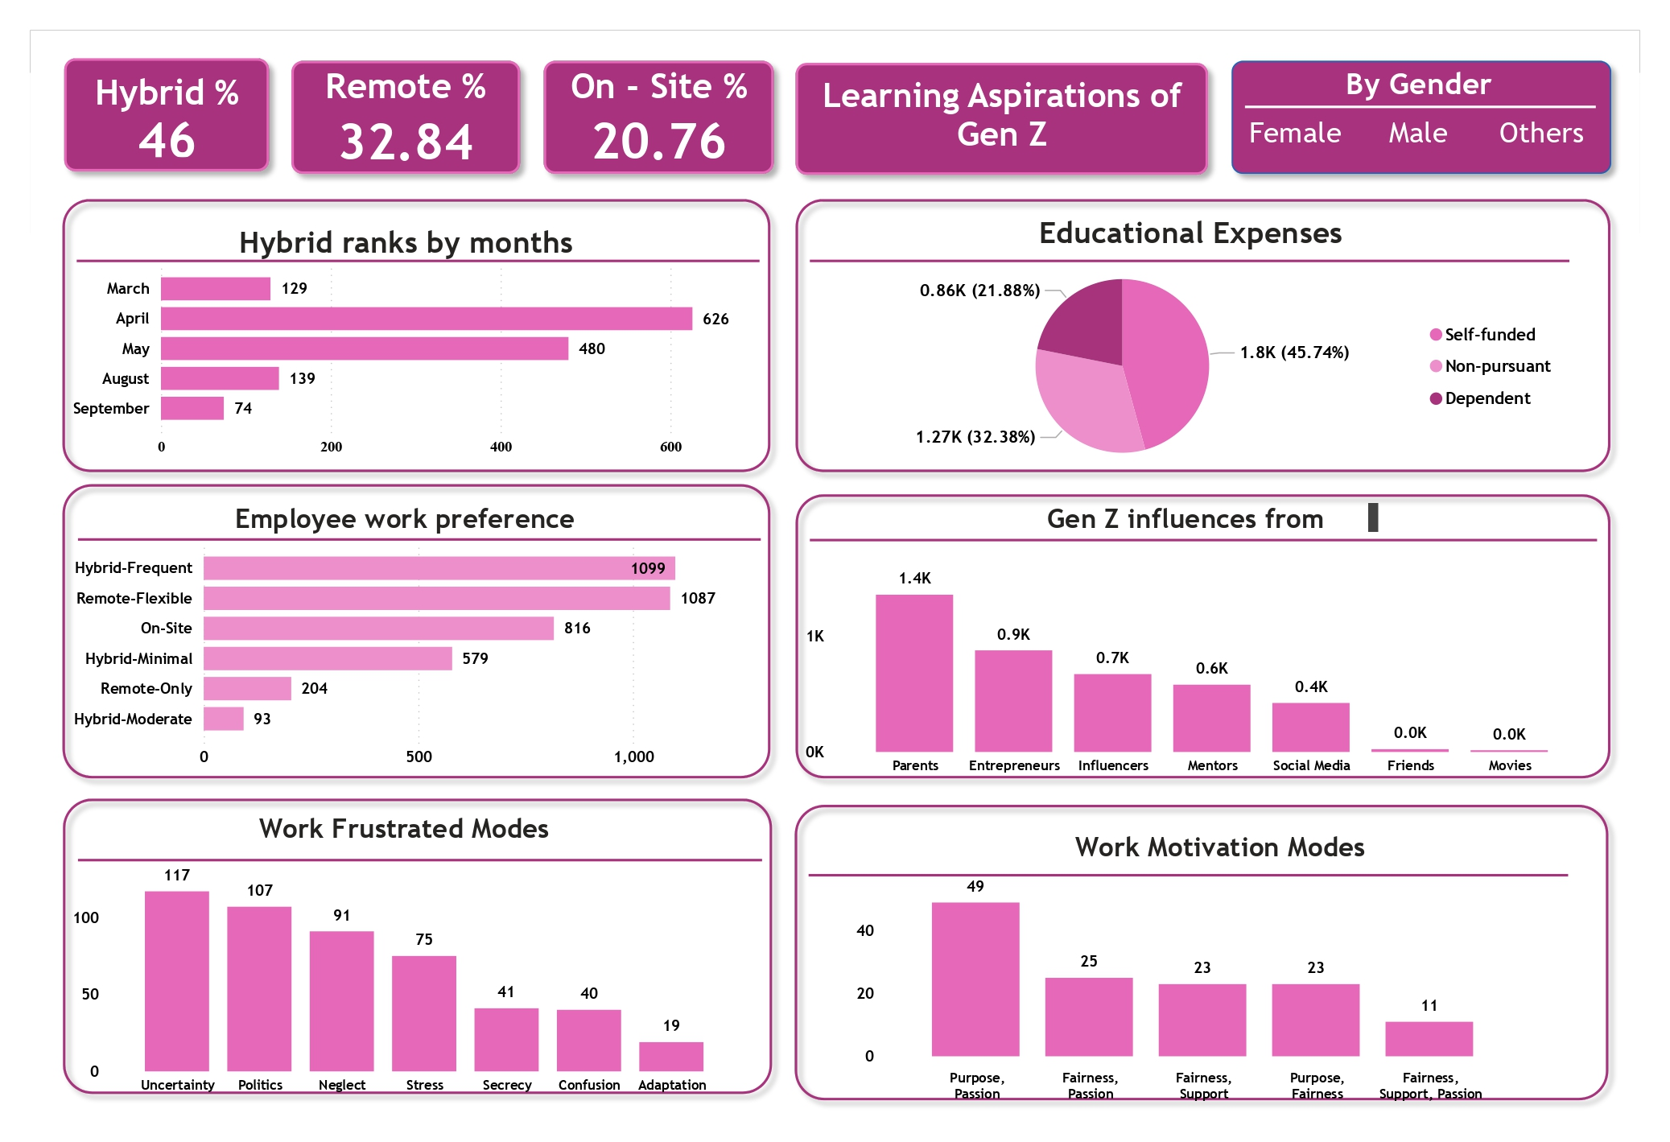
My Dashboarding Work

Slide 32
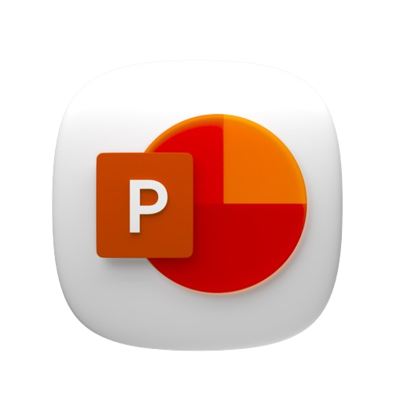
08
Presentation
My view
Generation Z, born between 1997 and 2012, is entering the workforce with strong digital skills, fresh perspectives, and a desire for purpose-driven careers. However, they also face challenges like mental health struggles, lack of soft skills, and adjusting to professional environments.
This presentation explores who Gen Z is, what they expect from their careers, the barriers they face, and how workplaces can support and engage them effectively.
Project Title: Understanding the Career Aspirations of Generation Z
Tools Used: Microsoft PowerPoint

Slide 33


My Experience
As part of my internship, I worked on the project titled "Understanding the Career Aspirations of Generation Z," which focused on analyzing the professional expectations, challenges, and behaviors of Gen Z employees in modern workplaces.
Over the span of 6 weeks, I conducted extensive research, evaluated reports from multiple global sources, and applied the 5W1H analytical framework to break down the topic into actionable insights. I analyzed over 10+ industry reports and case studies, extracting key statistics such as Gen Z's average 54 days of lost productivity per year due to mental health issues and the 1.2 million unemployed youth in the UK post-pandemic.
Key contributions:
Identified 5+ major challenges faced by Gen Z in the workforce, including communication gaps and rising mental health concerns.
Proposed 3 strategic solutions for employers: flexible work policies, mental health support, and inclusive company cultures.
Created a visually-supported presentation using graphs, infographics, and real-world data, helping simplify complex findings for stakeholders.
Through this project, I significantly improved my skills in data analysis, research writing, presentation design, and workforce psychology understanding. It also enhanced my ability to work independently, manage time effectively, and communicate insights in a structured and impactful manner.
Overall, this internship was a transformative learning experience that deepened my awareness of generational workforce dynamics and prepared me to tackle real-world HR and workplace challenges with confidence.

Slide 34

Thank You
Name: KEDARI SRI VENKATESH
Connect With Me:-
As I wrap up my internship journey, I want to take a moment to express my sincere gratitude for the incredible experience. This internship has been more than just a learning opportunity—it has been a journey of growth, reflection, and discovery.
Exploring the career aspirations of Generation Z has given me deep insights into modern workplace dynamics, mental health awareness, and the importance of adaptability in today’s ever-evolving professional world. I’ve gained valuable skills in research, analysis, and communication, and I’m walking away with not just knowledge, but a clearer vision of my own career path.
Thank you to everyone who supported and guided me throughout this experience. I’m excited to carry forward what I’ve learned and continue growing both personally and professionally.

